Slide 1
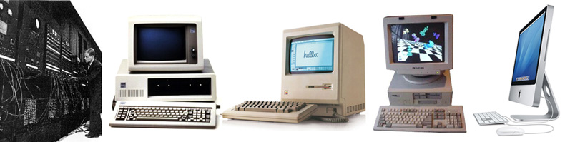
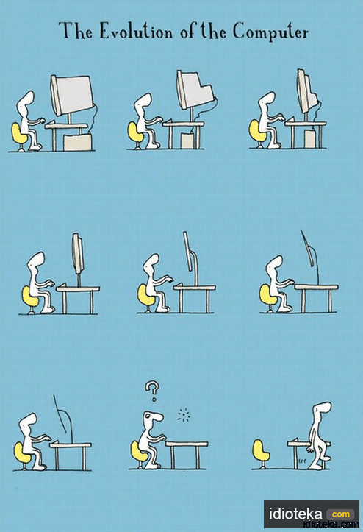
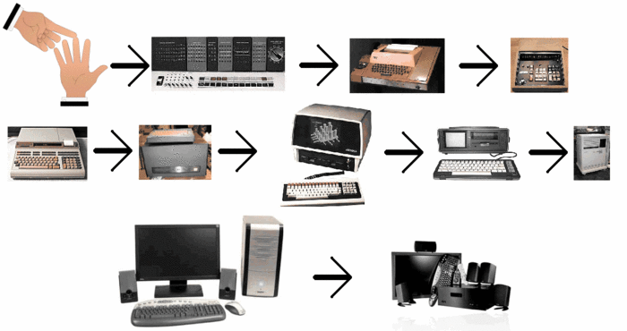
Generations of computers
Alexandr Dolinniy
IO-31

Slide 2
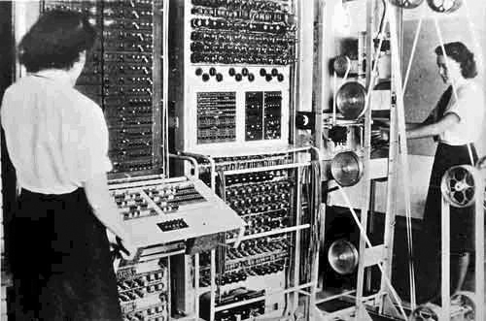
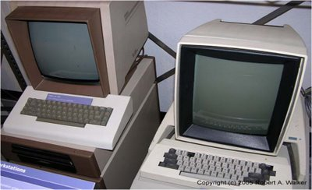
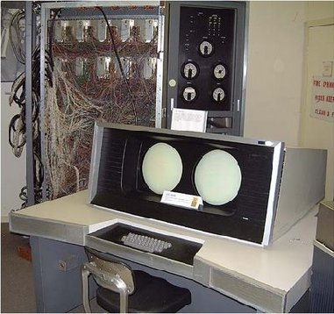
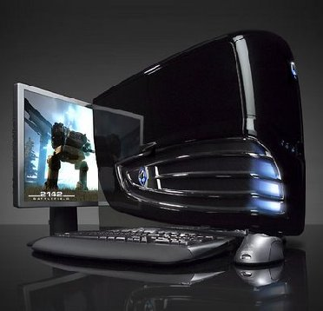
Generation in computer terminology is a change in technology a computer is/was being used.

Slide 3
Generations of computers
S.N. | Generation & Description
1 | First Generation The period of first generation: 1946-1955. Vacuum tube based.
2 | Second Generation The period of second generation: 1956-1964. Transistor based.
3 | Third Generation The period of third generation: 1965-1970. Integrated Circuit based.
4 | Fourth Generation The period of fourth generation: 1971-present... VLSI microprocessor based.
5 | Fifth Generation The period of fifth generation: ???. Artificial intelligence based.

Slide 4

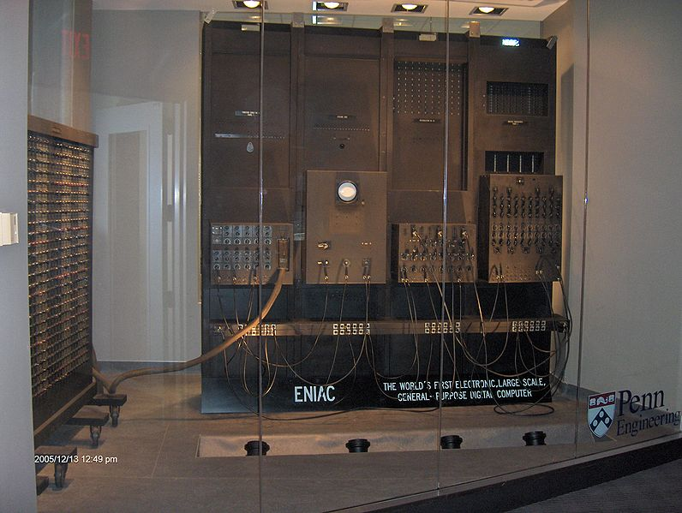
The first computer- ENIAC(1946)
Electronic Numerical Integrator And Computer( Presper Eckert, John Mauchly )
Number of vacuum tube was 17468.
P = 150 kWt
M = 27000 kg

Slide 5
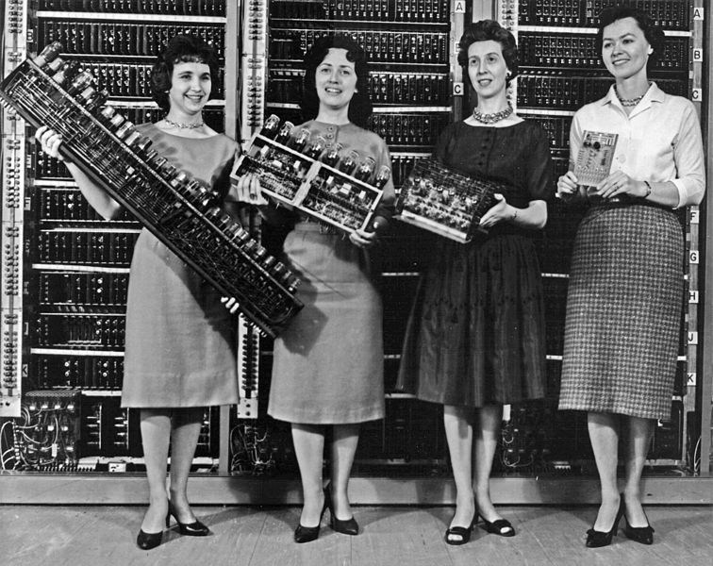
Parts from early computers: ENIAC, EDVAC, ORDVAC, and BRLESC I

Slide 6
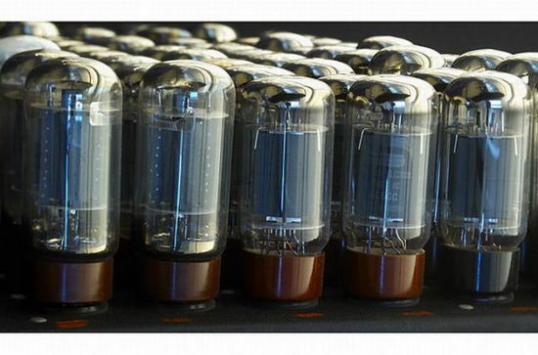

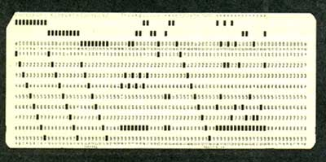
FEATURES OF FIRST GENERATION(1946-1955)
Vacuum tube technology
Unreliable
Supported Machine language only
Very costly
Generate lot of heat
Slow Input/Output device
Huge size
Non-portable
Consumed lot of electricity
Larger AC were needed

Slide 7
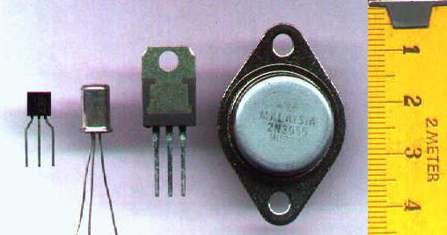
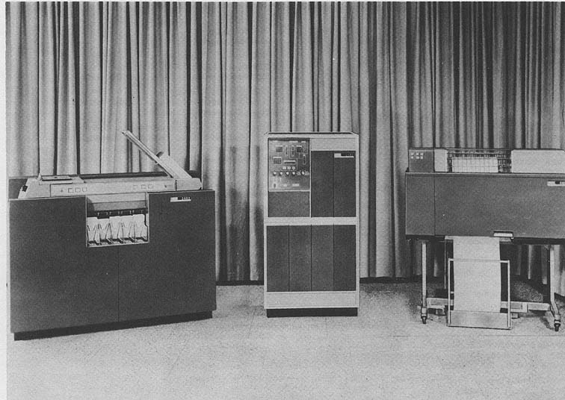
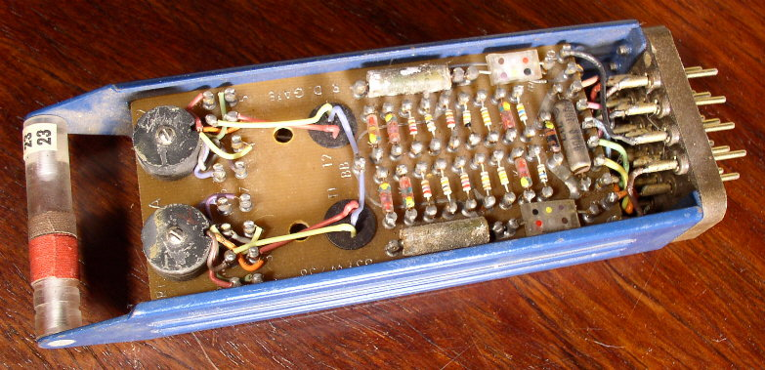
1947 – invention of transistor
John Bardeen,William Shockley, and Walter Brattain(AT&T's Bell Labs )

Slide 8
FEATURES OF SECOND GENERATION(1956-1964)
Use of transistors
Reliable as compared to First generation computers
Smaller size as compared to First generation computers
Generate less heat as compared to First generation computers
Consumed less electricity as compared to First generation computers
Faster than first generation computers
Still very costly
A.C. needed
Programming was in Machine Language & Aseembly Language
Magnetic tapes & discs were used

Slide 9
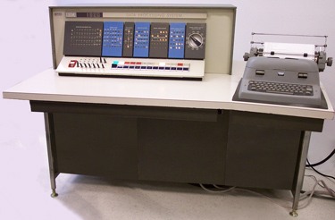
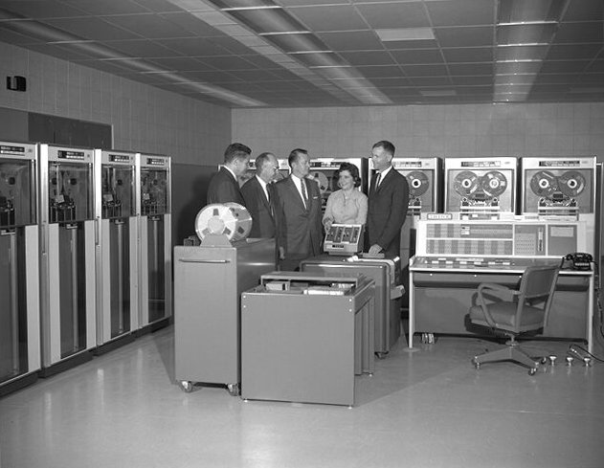
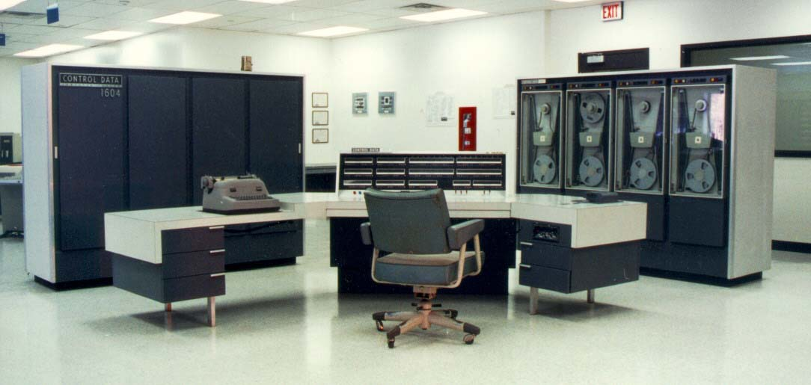
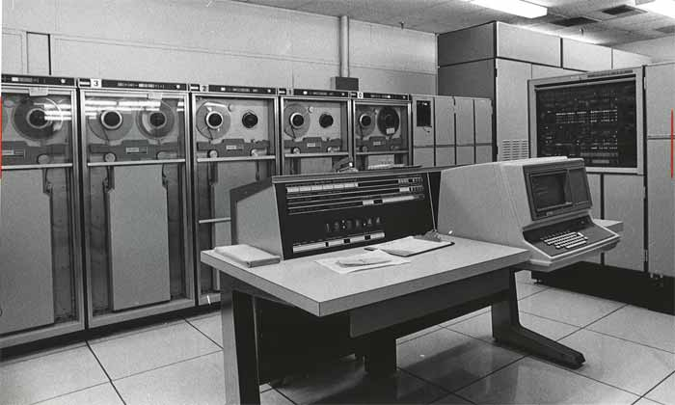
IBM 1620 (1959)
IBM 7094 (1960)
CDC 1604(1961)
UNIVAC 1108 (1964)

Slide 10
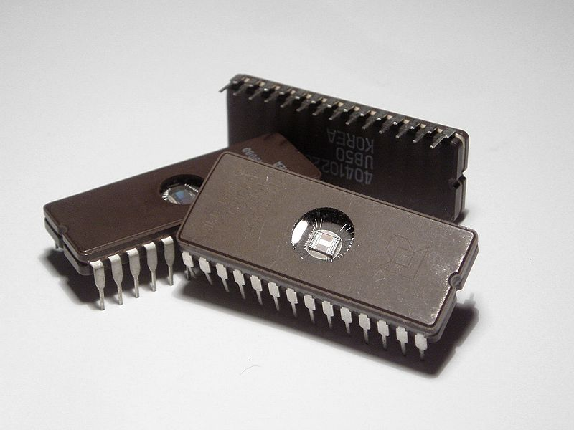
Integrated Circuits (1958)
Robert Noyce ,Jack Kilby

Slide 11
THIRD GENERATION FEATURES (1964-1970)
Integrated circuits developed
More reliable
Smaller size
Generate less heat
Faster
Still costly
Power consumption was low
Lesser maintenance
High level languages were used

Slide 12
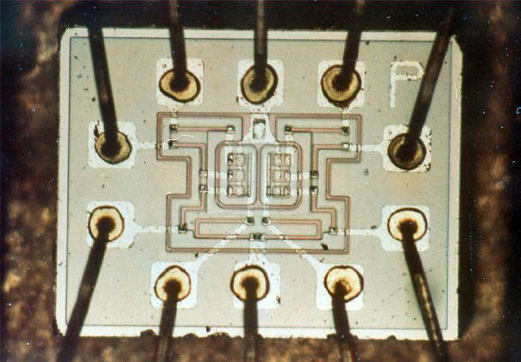
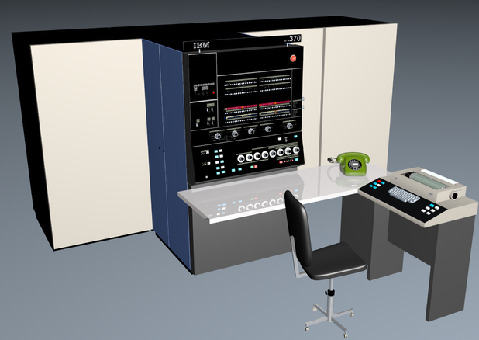
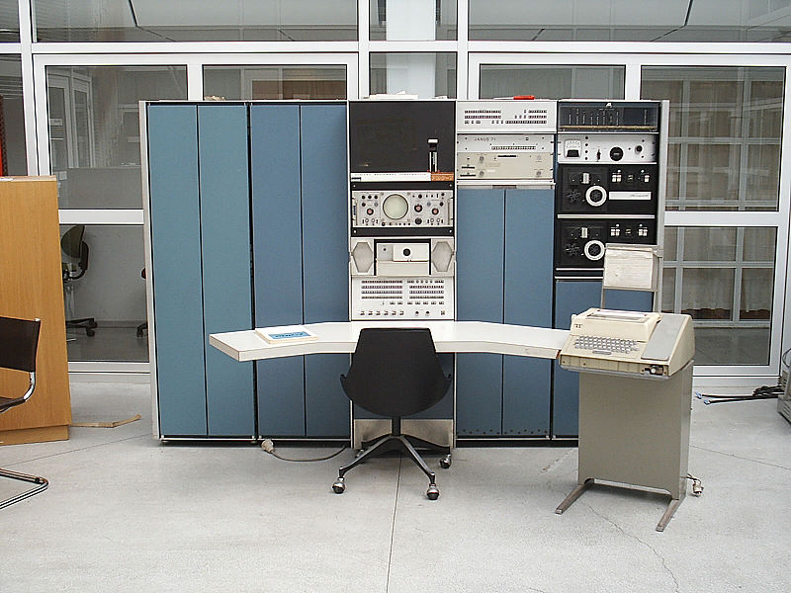
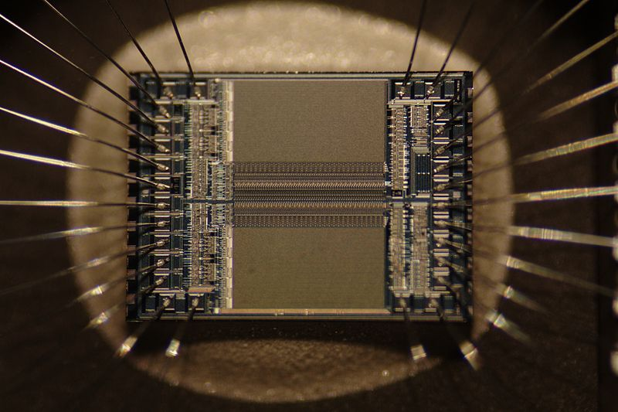
IBM-370/168 (1972)
PDP-7 (1965)

Slide 13
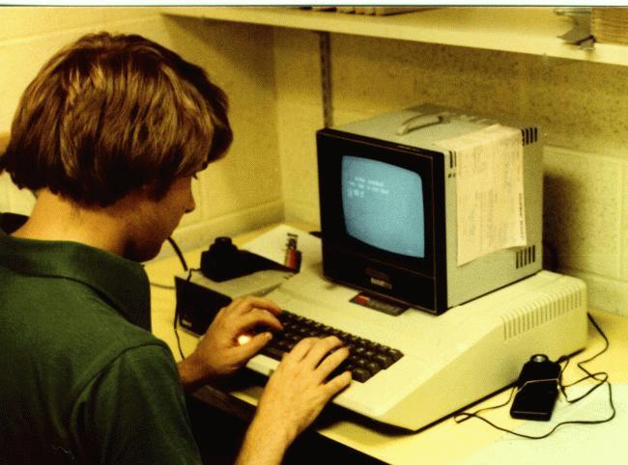
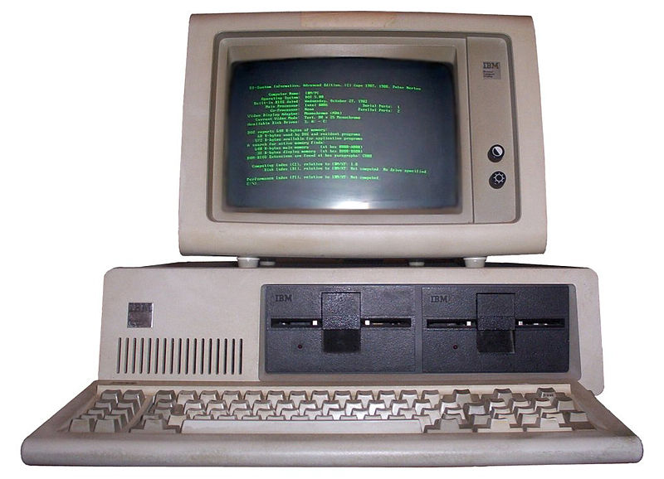
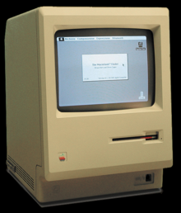
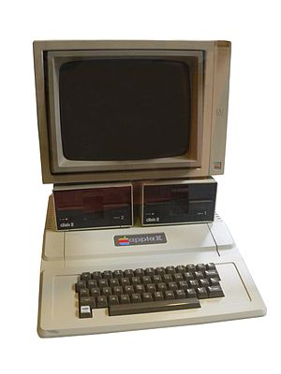
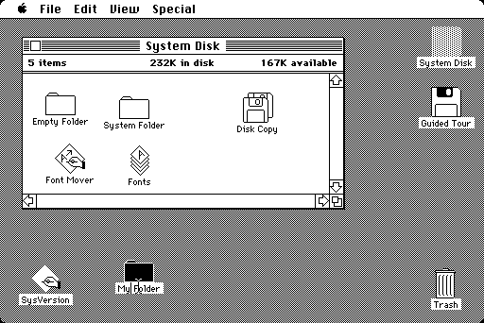
Altair 8800. 1975
IBM PC, 1981
Apple II, 1977
Macintosh, 1984

Slide 14
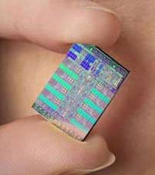
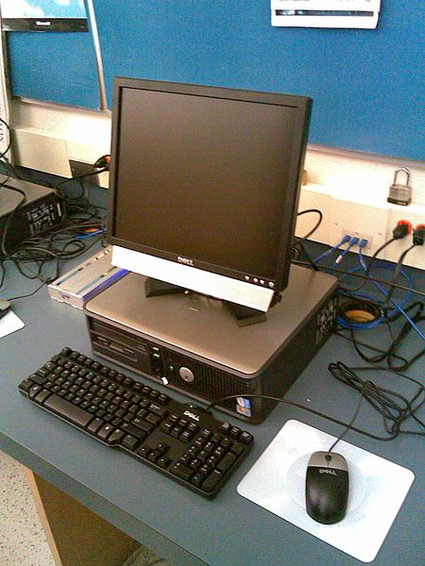
FOURTH GENERATION FEATURES (1971 – PRESENT)
Very-large-scale integration of ICs
Very small size
Very cheap
Portable and reliable
No A.C. needed
Development of Personal Computers
Computers became easily available
Different types of memories with very high accessing speed & storage capacity
Computers started in use for Data Communication with technology of internet
Great developments in the fields of networks
Used in virtual reality, multimedia, simulation
• DEC 10

Slide 15
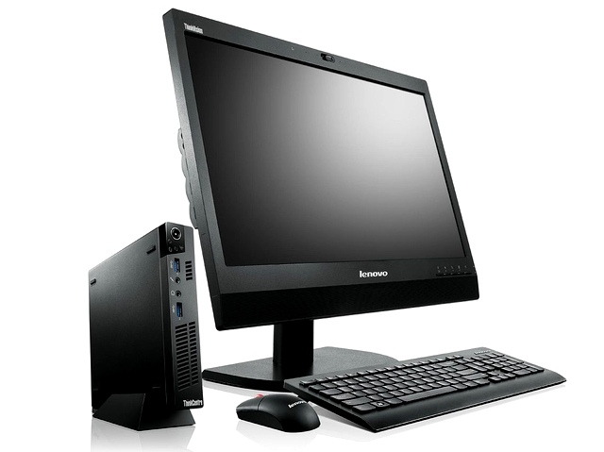
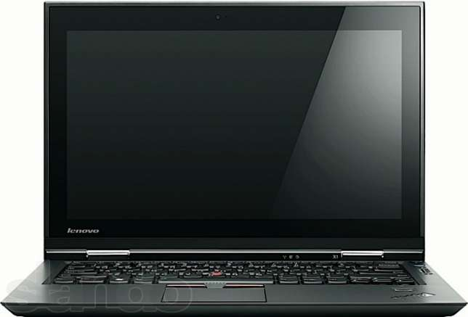
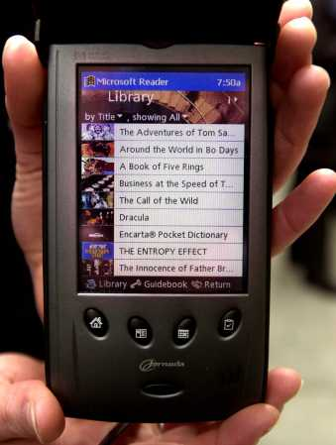
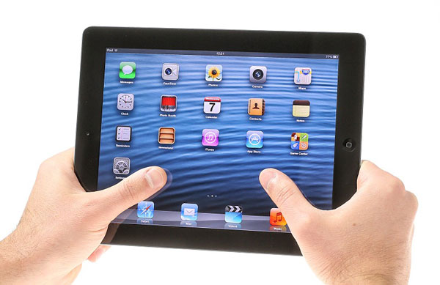

Slide 16
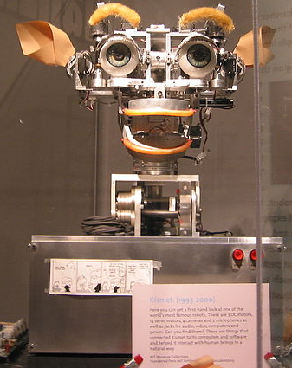
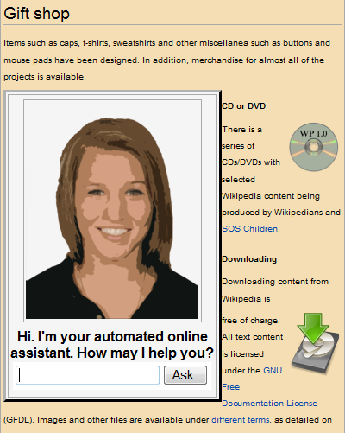
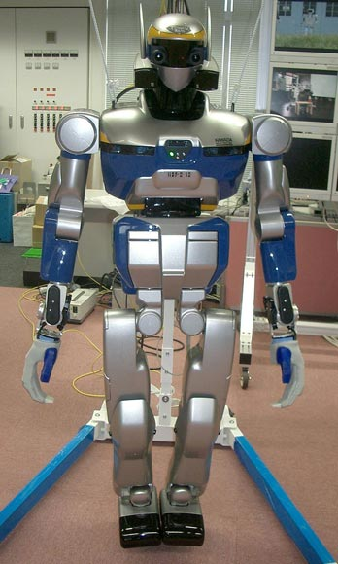
FIFTH GENERATION (???)
ARTIFICIAL INTELLIGENCE

